Slide 1
The Importance of a Worldview
Session 2
Dr. Lewis Winkler • East Asia School of Theology (Singapore) Uploaded by Dr. Rick Griffith • Jordan Evangelical Theological Seminary Files in many languages for free download at BibleStudyDownloads.org

Slide 2
Introduction: Case Study on Muslim Evangelism and Discipleship

Slide 3
Introduction
Why is studying and understanding the concept of a worldview so important?

Slide 4
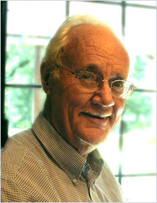
Why is studying and understanding the concept of a worldview so important?
Everyone has one.
Together, cognitive, affective, and evaluative assumptions provide people with a way of looking at the world that makes sense out of it, that gives them a feeling of being at home, and that reassures them that they are right. This worldview serves as the deep structure on which they construct their explicit belief and value systems and the social institutions in which they live their daily lives.
Paul Hiebert, Transforming Worldviews, 65

Slide 5
Why is studying and understanding the concept of a worldview so important?
Everyone has one.
All people need to unify their thought and life.

Slide 6
Why is studying and understanding the concept of a worldview so important?
Everyone has one.
All people need to unify their thought and life.
Worldviews provide filters for the overwhelming amounts of data that come to us through our senses.

Slide 7
Why is studying and understanding the concept of a worldview so important?
Everyone has one.
All people need to unify their thought and life.
Worldviews provide filters for the overwhelming amounts of data that come to us through our senses.
Worldviews provide plausibility structures to help us decide what things are believable and what things are ridiculous.

Slide 8
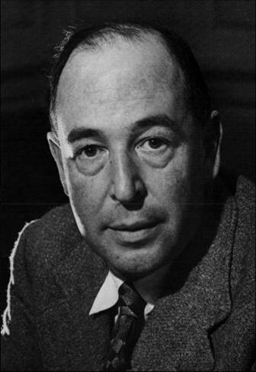
Why is studying and understanding the concept of a worldview so important?
Everyone has one.
All people need to know what is good (and bad).
Human beings, all over the earth, have this curious idea that they ought to behave in a certain way, and cannot really get rid of it.
C. S. Lewis, Mere Christianity, 21

Slide 9
Why is studying and understanding the concept of a worldview so important?
Everyone has one.
All people need a way to survive and live appropriately in the world.

Slide 10
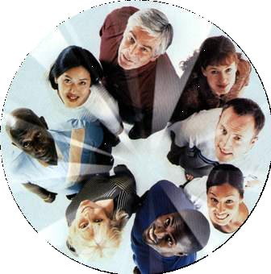
Why is studying and understanding the concept of a worldview so important?
Everyone has one.
All people need a way to survive and live appropriately in the world.
The Need to Belong to a Community:

Slide 11
Why is studying and understanding the concept of a worldview so important?
Everyone has one.
All people need a way to survive and live appropriately in the world.
The Need to Belong to a Community:
The Need for Emotional and Intellectual Security and Stability:

Slide 12
Why is studying and understanding the concept of a worldview so important?
Everyone has one.
All people need a way to survive and live appropriately in the world.
The Need to Belong to a Community:
The Need for Emotional and Intellectual Security and Stability:
The Need to Monitor and Deal with Change:

Slide 13
Why is studying and understanding the concept of a worldview so important?
The study and understanding of worldviews lead to a greater ability to make necessary changes in the way you perceive and interact with the world around you.

Slide 14
Why is studying and understanding the concept of a worldview so important?
The study and understanding of worldviews lead to a greater ability to make necessary changes in the way you perceive and interact with the world around you.
Conversely, ignorance of and/or ignoring these matters will often lead to arrogance, provincialism, cultural blindness, stagnation, and irrelevance.

Slide 15
Why is studying and understanding the concept of a worldview so important?
Christianity lays claim to a universal and comprehensive worldview.

Slide 16
Why is studying and understanding the concept of a worldview so important?
Christianity lays claim to a universal and comprehensive worldview.
Understanding worldviews leads to more effective witness.

Slide 17
Why is studying and understanding the concept of a worldview so important?
Christianity lays claim to a universal and comprehensive worldview.
Understanding worldviews leads to more effective witness.
Christians must take the worldviews of other people seriously, not because they agree with them, but because they want to understand the people they serve in order to effectively share with them the good news of the gospel.
Paul Hiebert, Transforming Worldviews, 69

Slide 18
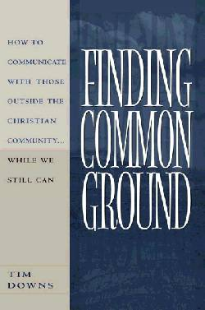
Why is studying and understanding the concept of a worldview so important?
Christianity lays claim to a universal and comprehensive worldview.
Understanding worldviews leads to more effective witness.
It helps us find common ground.

Slide 19
Why is studying and understanding the concept of a worldview so important?
Christianity lays claim to a universal and comprehensive worldview.
Understanding worldviews leads to more effective witness.
It helps us find common ground.
It bolsters our confidence in the Christian worldview.

Slide 20
Why is studying and understanding the concept of a worldview so important?
Christianity lays claim to a universal and comprehensive worldview.
Understanding worldviews leads to more effective witness.
It helps us find common ground.
It bolsters our confidence in the Christian worldview.
It helps us see weak points and problems in other worldviews.

Slide 21
Why is studying and understanding the concept of a worldview so important?
Christianity lays claim to a universal and comprehensive worldview.
Understanding worldviews leads to more effective discipleship.

Slide 22
Why is studying and understanding the concept of a worldview so important?
Christianity lays claim to a universal and comprehensive worldview.
Understanding worldviews leads to more effective discipleship.
It helps us see potential problems in our own worldview.

Slide 23
Why is studying and understanding the concept of a worldview so important?
Christianity lays claim to a universal and comprehensive worldview.
Understanding worldviews leads to more effective discipleship.
It helps us see potential problems in our own worldview.
It helps us avoid syncretism and false beliefs.

Slide 24
[I]f the worldview is not transformed, in the long run the gospel is subverted and the result is a syncretistic Christo-paganism, which has the form of Christianity but not its essence. Christianity becomes a new magic and a new, subtler form of idolatry.
Paul Hiebert, Transforming Worldviews, 11

Slide 25
Conclusion:

Slide 26
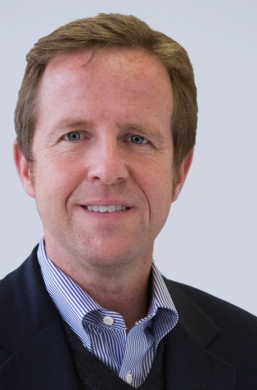
When Paul warns, therefore, about being deceived by vain philosophy, he has a particular problem in mind: this confusion of Christianity with Greek philosophy, the latter of which was allowed to intrude carelessly on the former to the extent that the definitions of God, creation, human nature, history, and redemption had been totally recast. Paul was not attacking philosophy per se, but Gnosticism in particular and the domination of theology by secular wisdom in general. That is precisely the problem we see in evangelicalism today . . . .
But the same apostle who warns against the incursions of philosophy also calls upon the Corinthians believers to encounter it: “We demolish arguments and every pretension that sets itself up against the knowledge of God, and we take captive every thought to make it obedient to Christ” (2 Corinthians 10:5). How can one demolish arguments if one is (a) unfamiliar with the arguments in the first place, (b) uninterested in the merit of those arguments, and (c) incapable of refuting them?
Michael S. Horton, Where in the World Is the Church?, 64

Slide 27
Black

Slide 28
Worldview link at BibleStudyDownloads.org
Get this presentation for free!
Notes:
WV (Worldviews)

